Slide 1

Paving Equity: Unveiling Socioeconomic Patterns in Pavement Conditions Using Data Mining
Authors:
Tamim Adnan, Graduate Research Assistant, Dept. of Civil and Environmental Engineering, Michigan Technological University, Houghton, MI, USA, 49931
Abdolmajid Erfani, Assistant Professor, Dept. of Civil and Environmental Engineering, Michigan Technological University Houghton, MI, USA, 49931

Slide 2
List of Contents
Introduction
Research Problems and Gaps
Research Questions
Research Objectives
Data Mining Methods
Related works
Research Methodology
Data Collection
Linear Correlation among the Features
Two-step Clustering Framework
Results
Key Notes on Inequitable Pavement Access
Future Works

Slide 3
Social Equity in Data-driven Transportation Asset Management
Equity Action Plan (USDOT):
Ensures fair and impartial treatment, prioritizing historically underserved communities.
AI Analytics Advantage:
Outperforms traditional metrics like variance, Gini index, and Theil’s entropy.
Social Equity :
Fair distribution of resources, opportunities, and benefits.
Rawls's theory of justice:
Fair distribution for underserved groups
Influencing Factors:
Income, race, education, urbanization, employment and more.

Slide 4
Quality of Access in Pavement Conditions
Higher Poverty Rates and Underserved Racial Groups Experienced disparities in Pavement Conditions. (U.S Government Accountability Office (GAO) Report, 2022
Significant disparities in Pavement Conditions between the advantaged and disadvantaged groups by household income variations (Towsend 2022)
Minorities facing transportation, housing, and language barriers experienced poorer road qualities (Erfani et al. 2024)

Slide 5
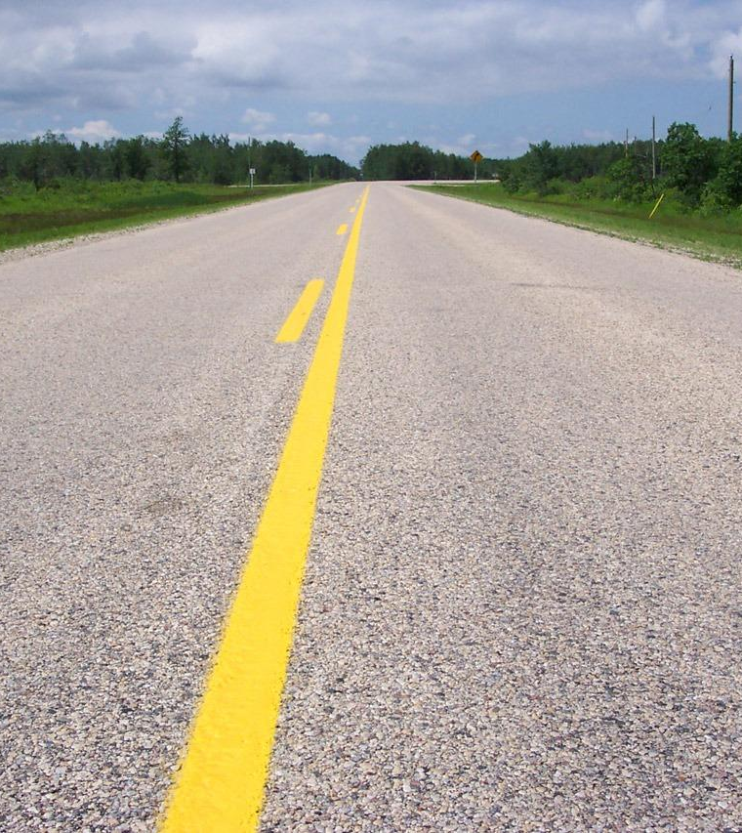
The Need for Quality Access in Good
Pavement Conditions
Fair Resource Allocation and Budget Constraints
Equity-Focused Policies for Diverse Groups
Data Analysis for Equitable Decisions
Natural Hazard Emergencies for underserved groups
Safe Road Network Regardless of Socioeconomic Status

Slide 6
Research Problems and Gaps
Equitable Access Drivers
Traffic and climate influence pavement access, but the socio-economic impact remains unexplored.
Need for Advanced Analysis
Data-driven methods, such as data mining, require broader applications for equity insights.

Slide 7
Research Questions
How does pavement quality vary across socioeconomic groups?
What can an advanced data mining reveal about pavement access patterns?

Slide 8
Research Objectives
Evaluate Social Equity
  Assess disparities in pavement quality across socio-economic groups.
Apply Data Mining
  Use advanced two-step clustering to analyze U.S. road data.
Investigate Influential Factors
  Exploring the patterns of traffic, environmental conditions, and budgets on roads.
Inform Policy Decisions
  Offer insights to improve equity in pavement maintenance and funding.

Slide 9
Data Mining Methods
Clustering Techniques | Type / Clustering Groups | Advantages | Limitations
K-Means | Unsupervised Machine Learning | Simple and efficient for large data sets | Sensitive to outliers and initial centroids Limited to Continuous Data; Unsuitable for Mixed Data
K-Means++ | Unsupervised Machine Learning | Better initialization process reduces chances of poor clustering | Still sensitive to outliers and noise; Limited to Continuous Data
Agglomerative Clustering | Hierarchical Clustering Unsupervised Machine Learning | Reveal data hierarchy, Good for variable cluster sizes | Computationally expensive, not suitable for large datasets; Sensitive to Outliers; Unsuitable for continuous and categorical data simultaneously
DBSCAN | Density-Based Spatial Clustering | Does not require specification of number of clusters Handles outliers well | Performance degrades with high-dimensional data; Sensitive to parameter settings; Struggles with varying densities
Gaussian Mixture Models (GMMs) | Overlapping clusters | Soft clustering capabilities Flexibility in cluster covariance | Requires expectation-maximization which can be slow; Assumes normal distribution of components; Sensitive to initialization
Self-Organizing Maps | Neural Networks / Grid-based clusters | Visual representation of high-dimensional data Preserves topological properties | Training can be slow, parameters like grid size can affect output; Computationally intensive; May not represent complex topologies well

Slide 10
Clustering Techniques | Type / Clustering Groups | Advantages | Limitations
Principal Component Analysis (PCA) with Clustering | Dimensionality Reduction and Clustering | Reduces dimensionality maintaining as much variability as possible | Information loss, Assumes linear correlations between features;
Deep Learning-based Clustering (Autoencoders) | Neural Networks | Can learn complex nonlinear transformations, Useful for dimensionality reduction | Requires large amounts of data and computing resources
Spectral Clustering | Graph-based Clustering | Effective in identifying clusters in non-Euclidean spaces, Can handle complex structures | Computationally intensive for large dataset Depends on graph structure
HDBSCAN | Hierarchical DBSCAN Unsupervised Machine Learning | Automatically determines the number of clusters, Robust to noise | More complex than DBSCAN, Higher computational cost Computationally intensive for large datasets
Latent Dirichlet Allocation (LDA) | Topic Modeling | Good for discovering abstract topics in document collections | Requires pre-set number of topics, Can be sensitive to model parameters; Assumes document-topic distributions are sparse; Requires selection of topics beforehand
t-SNE | Dimensionality Reduction | Effective at creating visually interpretable maps of high-dimensional data | Computationally intensive; Sensitive to perplexity parameter; Not suitable for high-dimensional clustering directly

Slide 11
Related works
Study | Key Focus | Methods Used
Seyedrezaei et al. (2023) | Connection of social equity theories and equity in built-environments | Systematic Review
Townsend, C.E. (2022) | Identifying pavement distress and its socioeconomic impacts | Deep Learning (YOLO5)
Radovic et al. (2017) | Analysis of National Bridge Inventory | Two-Step Cluster Analysis
Moscoso et al. (2024) | Forecasting superstructure deterioration | Markov Chains, Two-Step Cluster Analysis
U.S. GAO (2022) | Influence of poverty and racial disparities on pavement conditions | Data Analysis
Erfani et al. (2024) | Impact of socioeconomic factors on pavement performance | Regression, Statistical Correlation Analysis

Slide 12
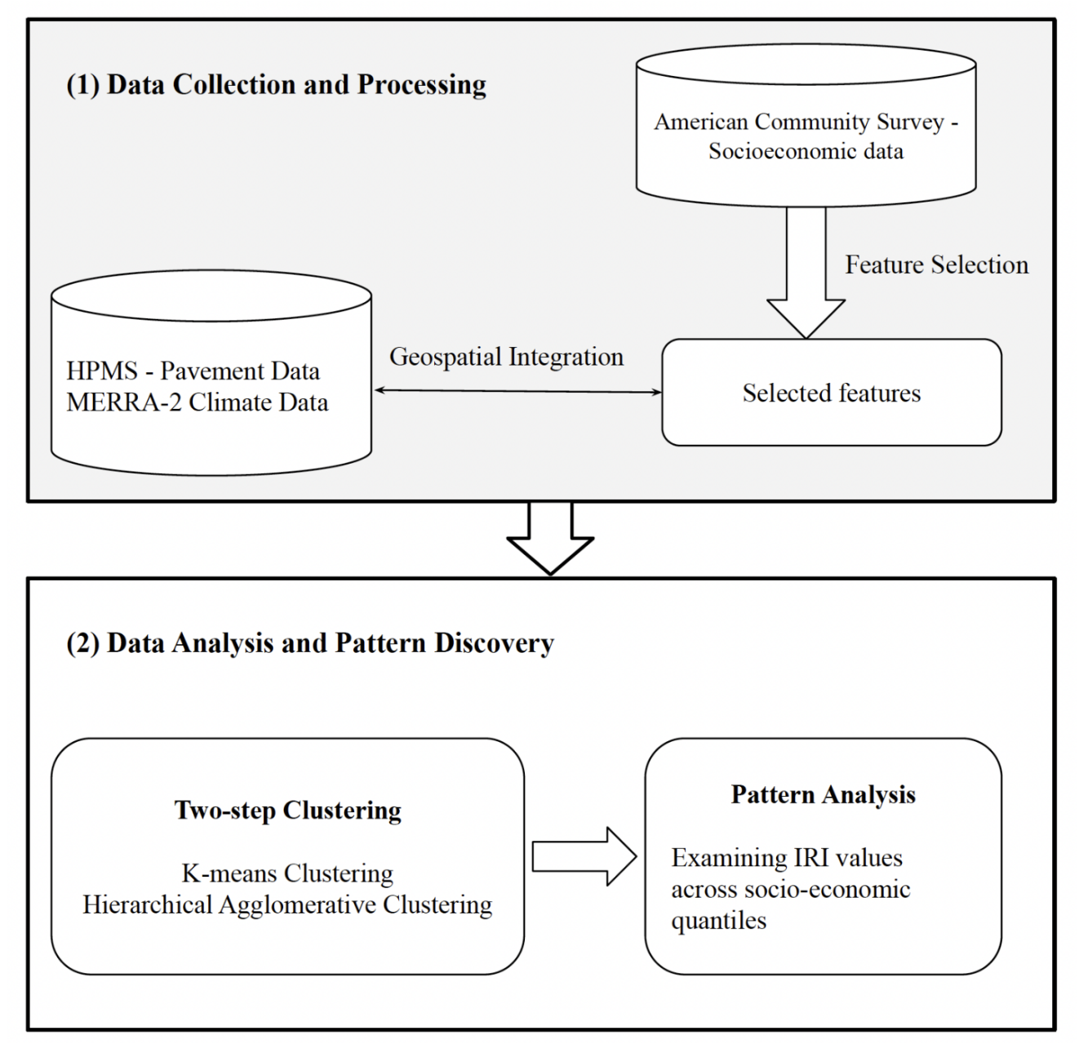
Research Methodology

Slide 13
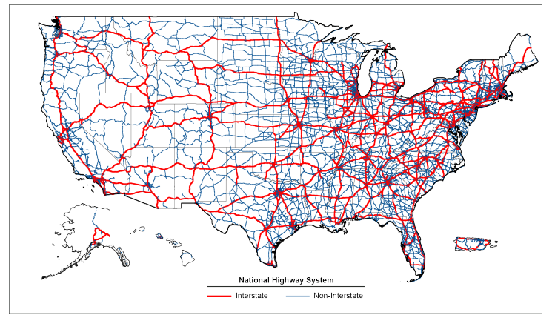
Data Collection
Highway Performance Monitoring Systems (HPMS):
The HPMS database is a resource of 8,487,369 records U.S nationwide for Pavement Performance.
Useful resource for:
International Roughness Index (IRI),
Road type
Surface characteristics
Base thickness
Traffic volume, and geospatial locations
Including other pavement-related information.
HPMS Data Model Structure

Slide 14
Data Collection
NASA Modern-Era Retrospective Analysis for Research and Application version 2 (MEERA-2):
Spatial and temporal information at the county level were found here.
American Community Survey (ACS):
  The United States Census Bureau conducts ACS data on
  income levels,
  Educational attainments,
  Employment rates,
  Racial demographics,
  Household compositions,
  other relevant information to provide detailed socioeconomic profiles of U.S. residents.
Provides ACS 1-year estimate and ACS 5-year estimate with more data points and minimal missing values.
Two-Step Clustering

Slide 15
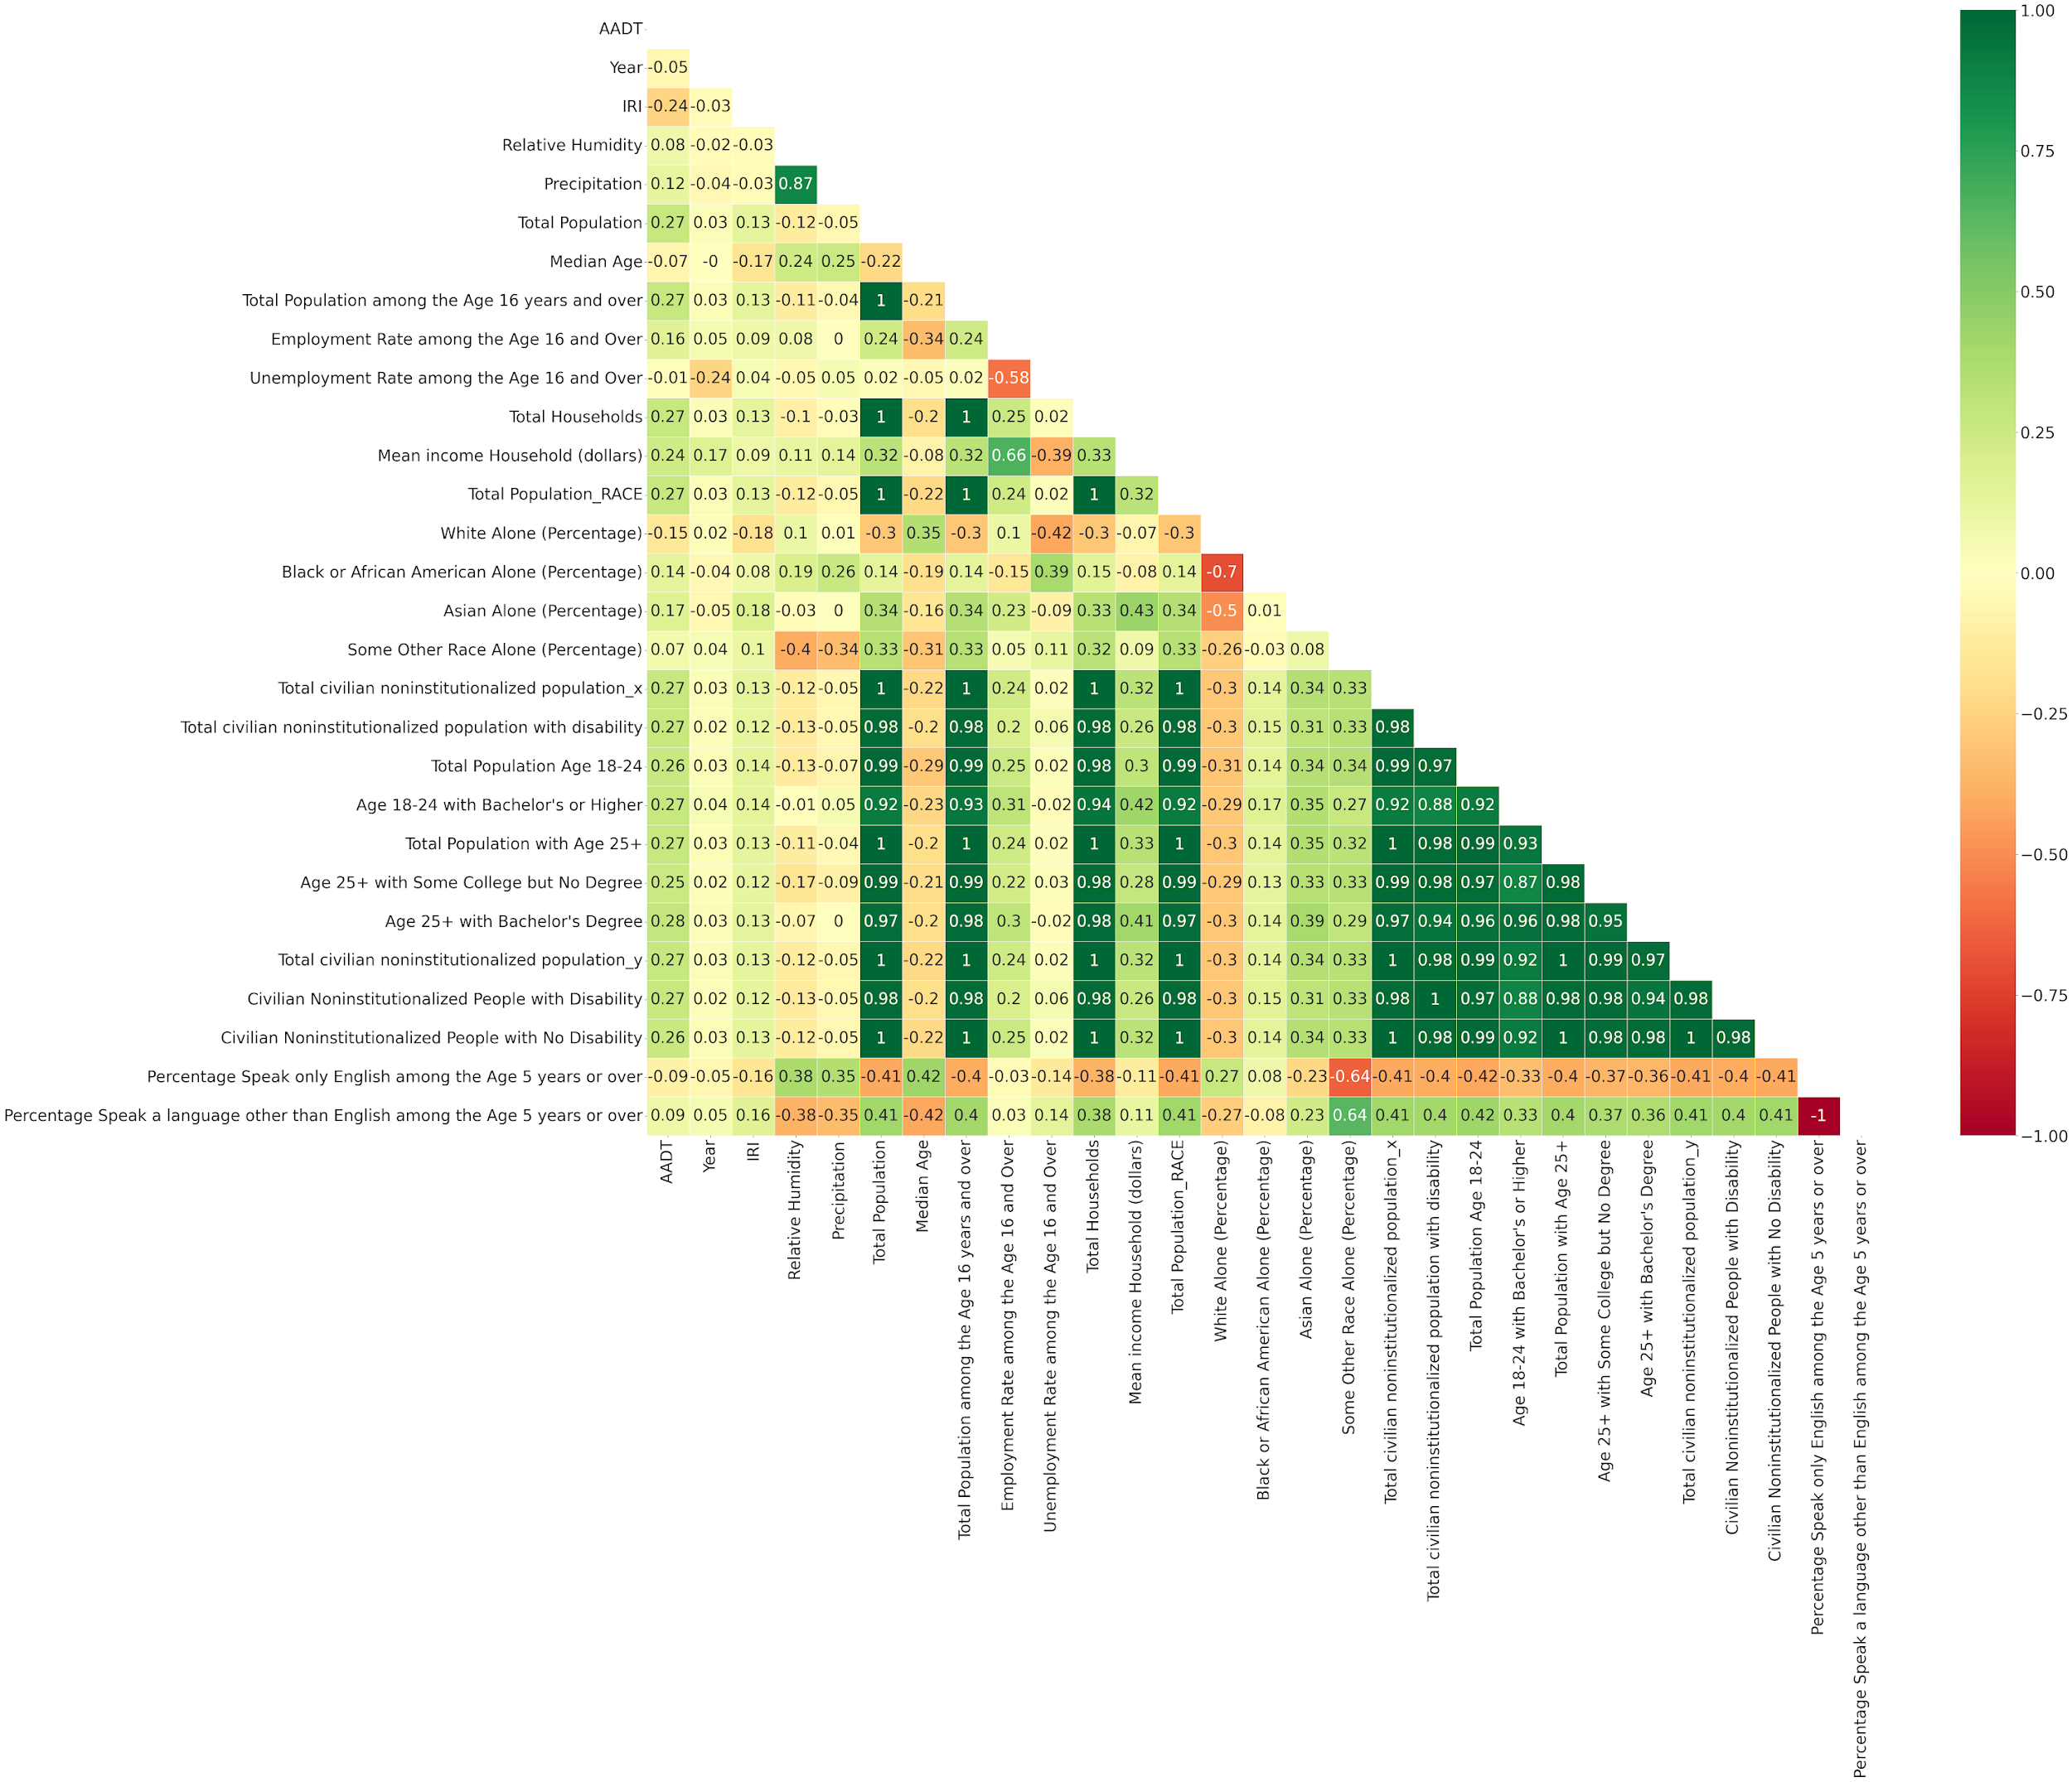
Linear Correlation among the Features
Multiple variables showed collinearity above 0.8, only one
variable was retained while the others were excluded,

Slide 16
Variable | Category | Variable Source | Description
Pavement Condition Index | IRI | HPMS | International Roughness Index (IRI) ranges from 0 to 253, with larger values indicating poorer road conditions.
Urbanity | Urban Code Mode | HPMS | The variable is categorical, where the code 9999 represents rural areas, 9998 represents small urban areas, and all other codes represent urban areas.
Traffic Data | AADT | HPMS | Annual Average Daily Traffic.
Environmental | Precipitation | MERRA-2 | Water equivalent of annual surface precipitation (measured in millimeters).
Income | Median Household Income | ACS | Income (dollars).
Age | Median Age | ACS | Median age of population.
Employment | Total Population among the Age 16 years and over | ACS | Total population over age 16.
 | Employment Rate among the Age 16 Years and over | ACS | Employment Rate for Individuals Aged 16 and Older.
 | Unemployment Rate among the Age 16 Years and over | ACS | Unemployment Rate for Individuals Aged 16 and Older.
Racial Backgrounds | White Alone ( Percentage) | ACS | Only White people population.
 | Black or African American Alone (Percentage) | ACS | Only Black or African American alone population.
 | Asian Alone (Percentage) | ACS | Only Asian alone population.
 | Some Other Race Alone (Percentage) | ACS | Only some other race alone population.
Disability | Total Civilian Population with Disability | ACS | Population with disability.
Education | Age 25+ Bachelor’s Degree | ACS | Population with age over 25 and bachelor’s degree above.
Language | Speak only English among the Age 5 Years or over | ACS | Population percentage only speak English.
 | Speak a language other than English among the Age 5 Years or over. | ACS | Population percentage speak other than English.

Slide 17
Two-step Clustering Framework
K-means Clustering
(First Step)
Hierarchical or Agglomerative clustering
(Final Step)
Two-Step Clustering
Two-Step Clustering
Pattern Analysis
Reference: IBM.(2024). “Two Step cluster node”. https://www.ibm.com/docs/en/cloud-paks/cp-data/4.8.x?topic=modeling-twostep-cluster-node,accessed 29th March 2024.

Slide 18
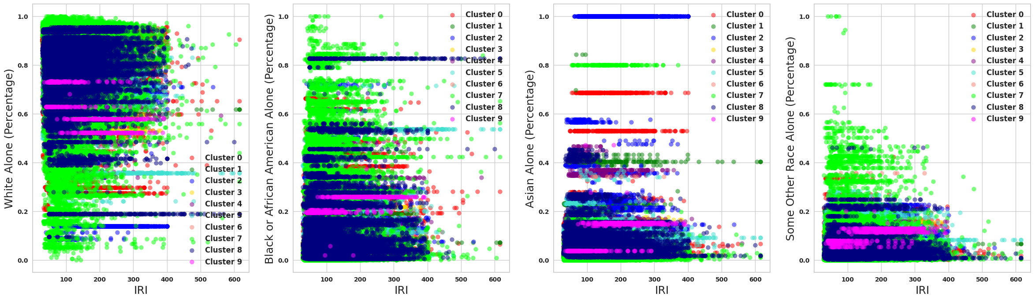
Optimal K-Means Cluster Number Selection
Number of Clusters | Silhouette Score | Davies Bouldin Score
2 | 0.87 | 0.46
3 | 0.77 | 0.43
4 | 0.73 | 0.39
5 | 0.62 | 0. 46
6 | 0.56 | 0.51
7 | 0.56 | 0.44
8 | 0.55 | 0.47
9 | 0.55 | 0.45
10 | 0.50 | 0.49
Pre-clusters
(K-Means Clustering)

Slide 19
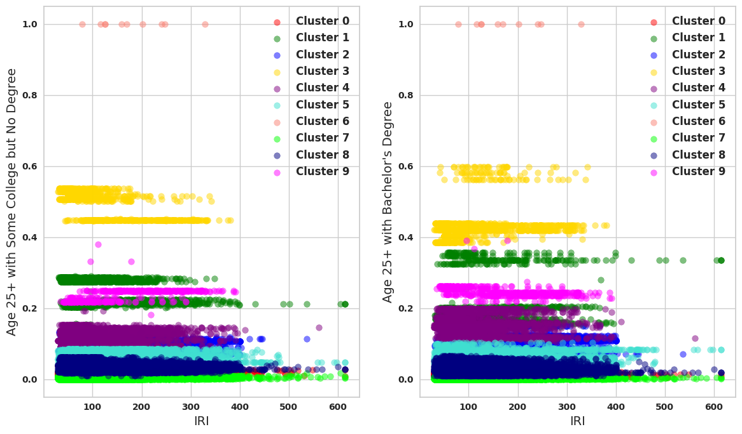
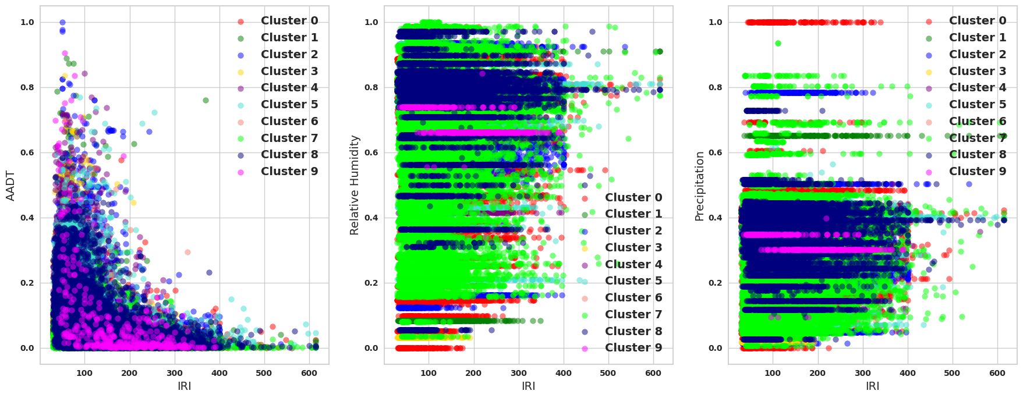
Pre-clusters
(K-Means Clustering)

Slide 20
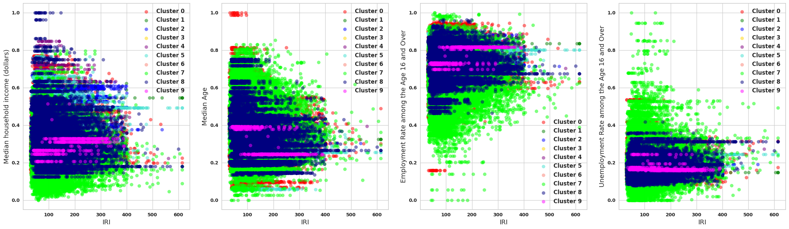
Pre-clusters
(K-Means Clustering)

Slide 21
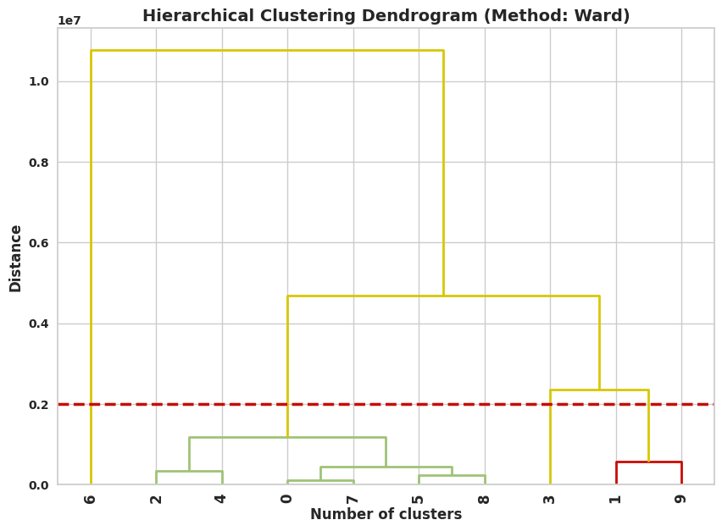
Optimal Hierarchical Cluster Number Selection
Optimal Hierarchical Cluster Number Selection
Number of Clusters | Silhouette Score | Davies Bouldin Score
2 | 0.67 | 0.49
3 | 0.57 | 0.57
4 | 0.56 | 0.56

Slide 22
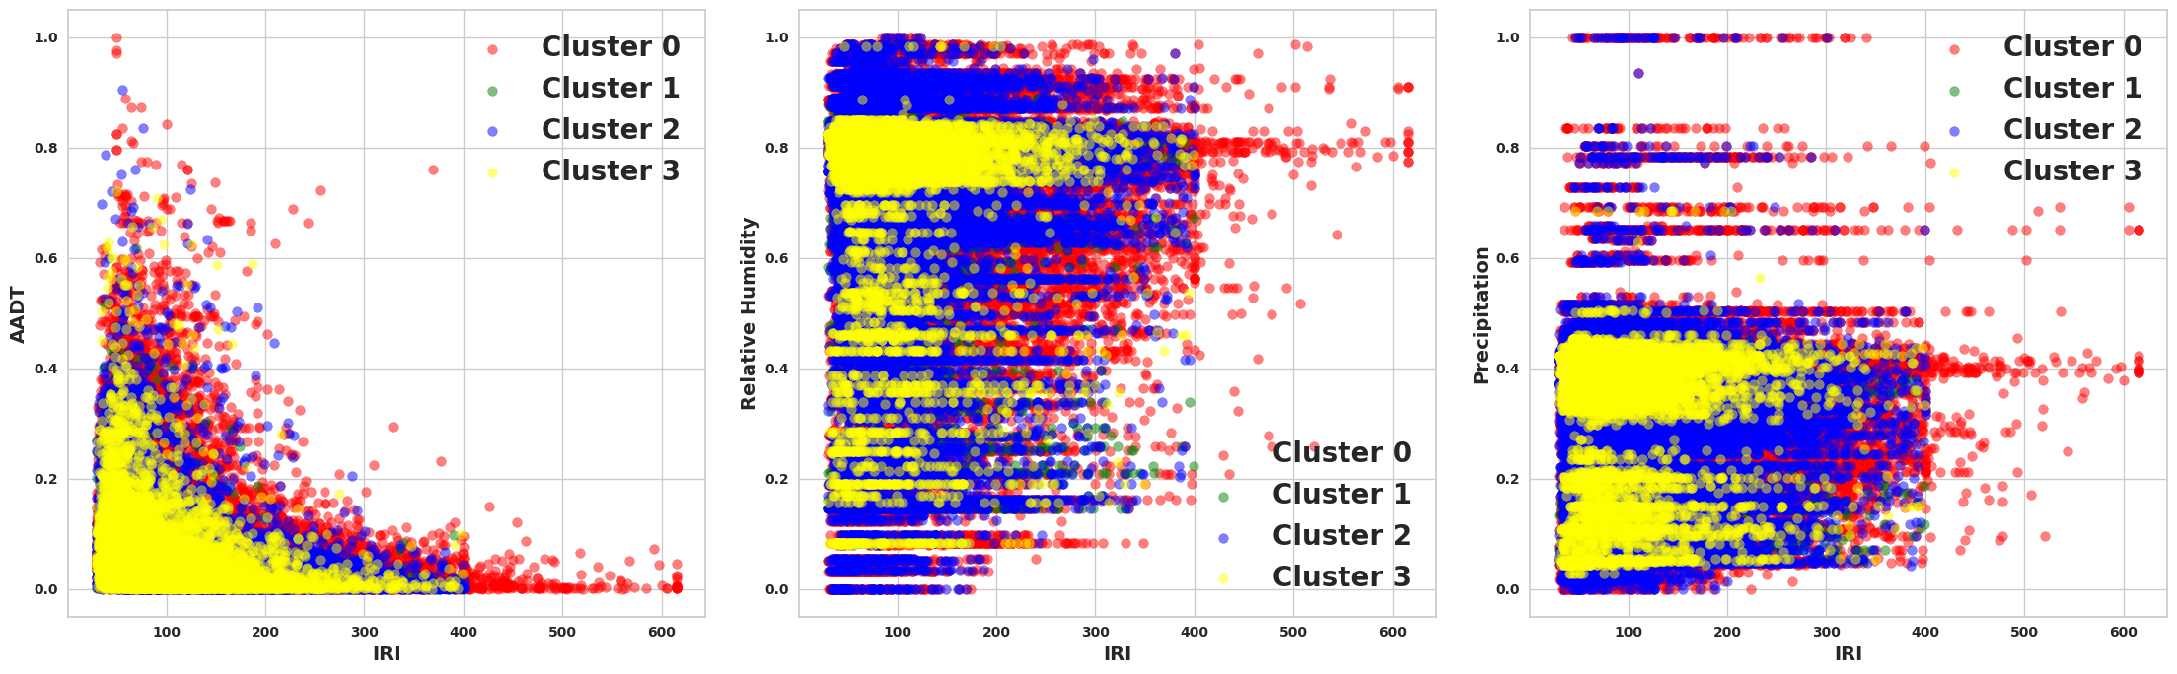
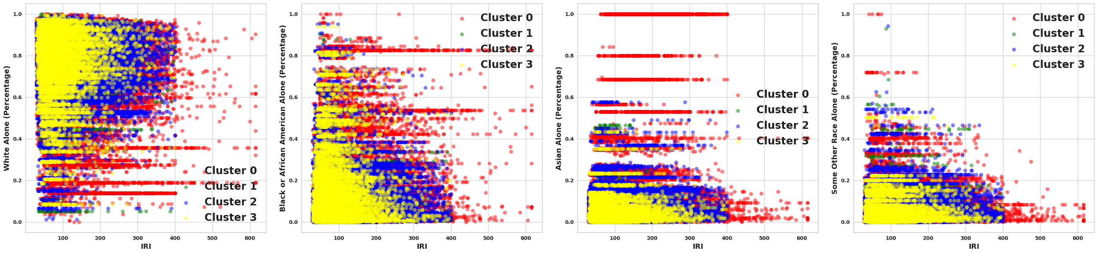
Final Clusters

Slide 23
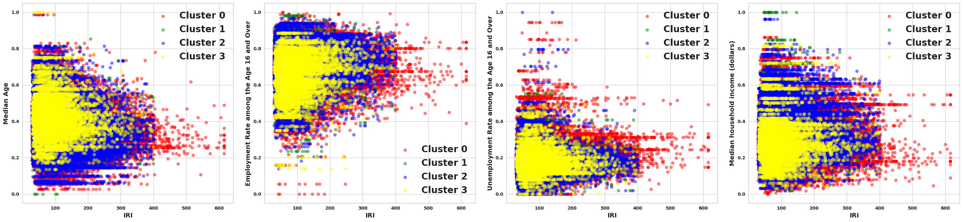
Final Clusters

Slide 24
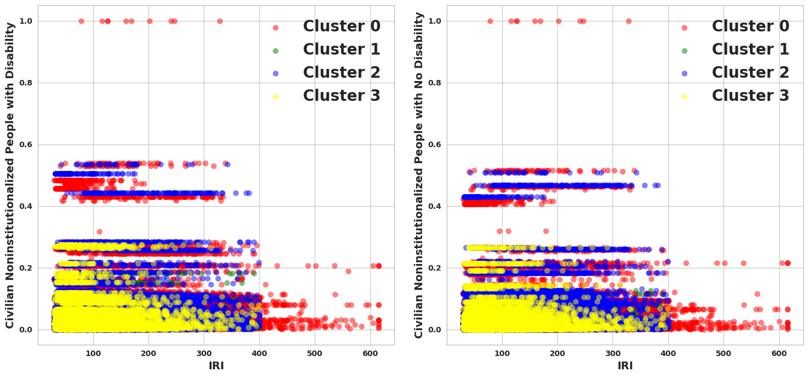
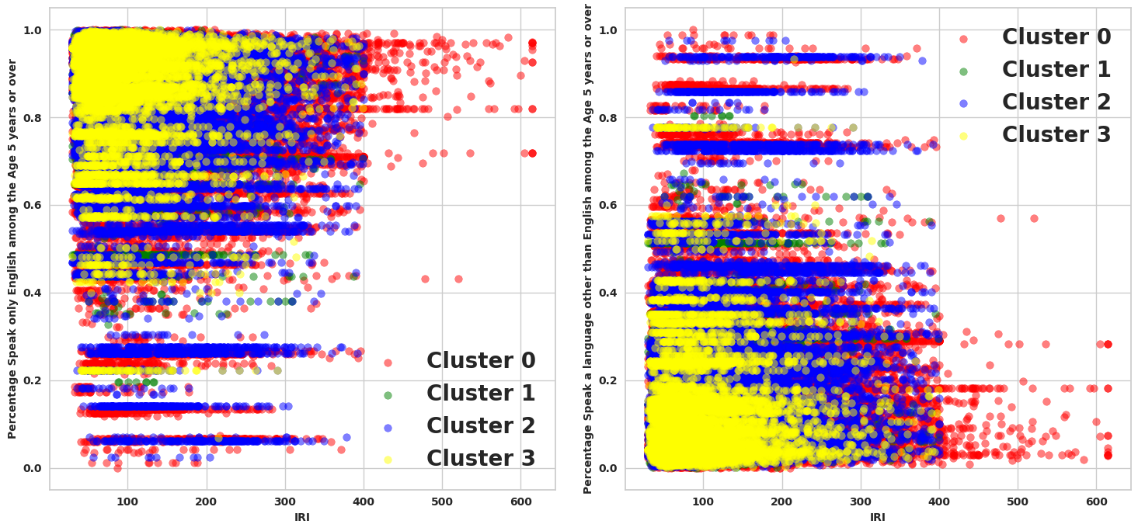
Final Clusters

Slide 25
Result: Pattern Analysis
Quantile Grouping of IRI
Data points grouped into IRI quantiles (Q1-Q4) in Final Clusters for Decision-making.
IRI Quantile Scale:
  Q1: Good Condition
  Q2: Acceptable Condition
  Q3: Poor Condition
  Q4: Poorer Condition
Standardization: All socio-economic features scaled (0-1) using Min-Max scaler for uniform comparison.
Feature Averages by Quantile
  Calculated average values of socio-economic variables in each IRI quantile within four clusters.
  Correlations observed between worsening pavement quality (Q1 → Q4) and socio-economic disparities.

Slide 26
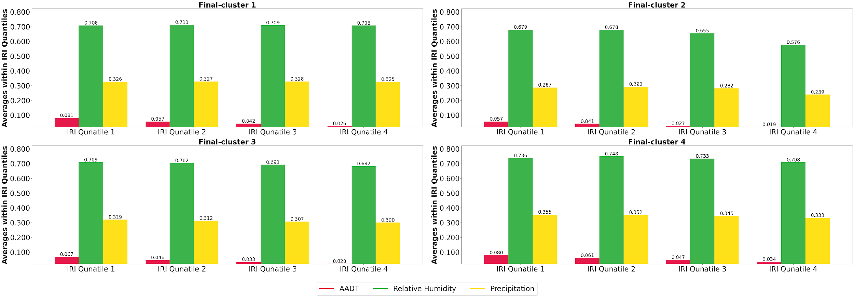
AADT, Relative Humidity and Precipitation on Pavement Quality
Declines in AADT, Relative Humidity, and Precipitation are associated with poor pavement quality

Slide 27
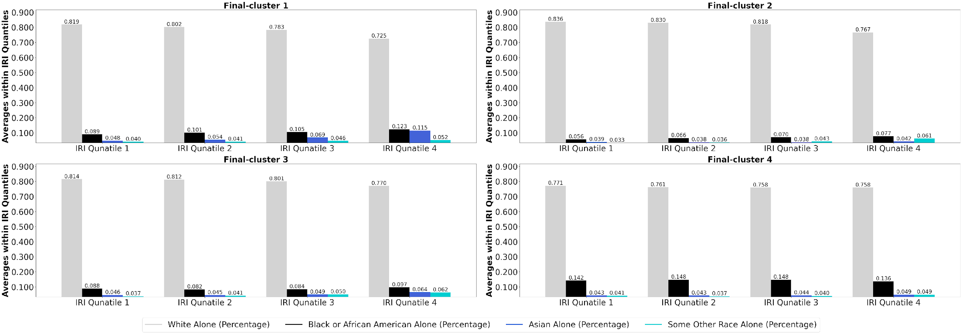
RACE on Pavement Quality
Poor pavement regions correlate with fewer White and more Minority residents

Slide 28
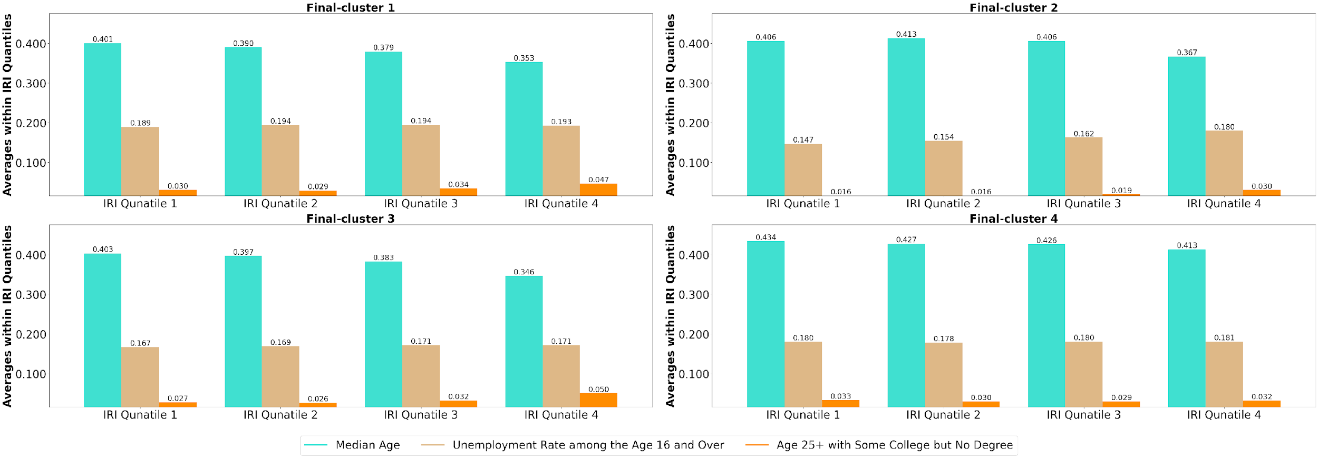
Age, Employment and Education on Pavement Quality
A decrease in median age as pavement quality declines
Unemployment rate increases as pavement quality declines
Education attainments are lower in the pavement regions

Slide 29
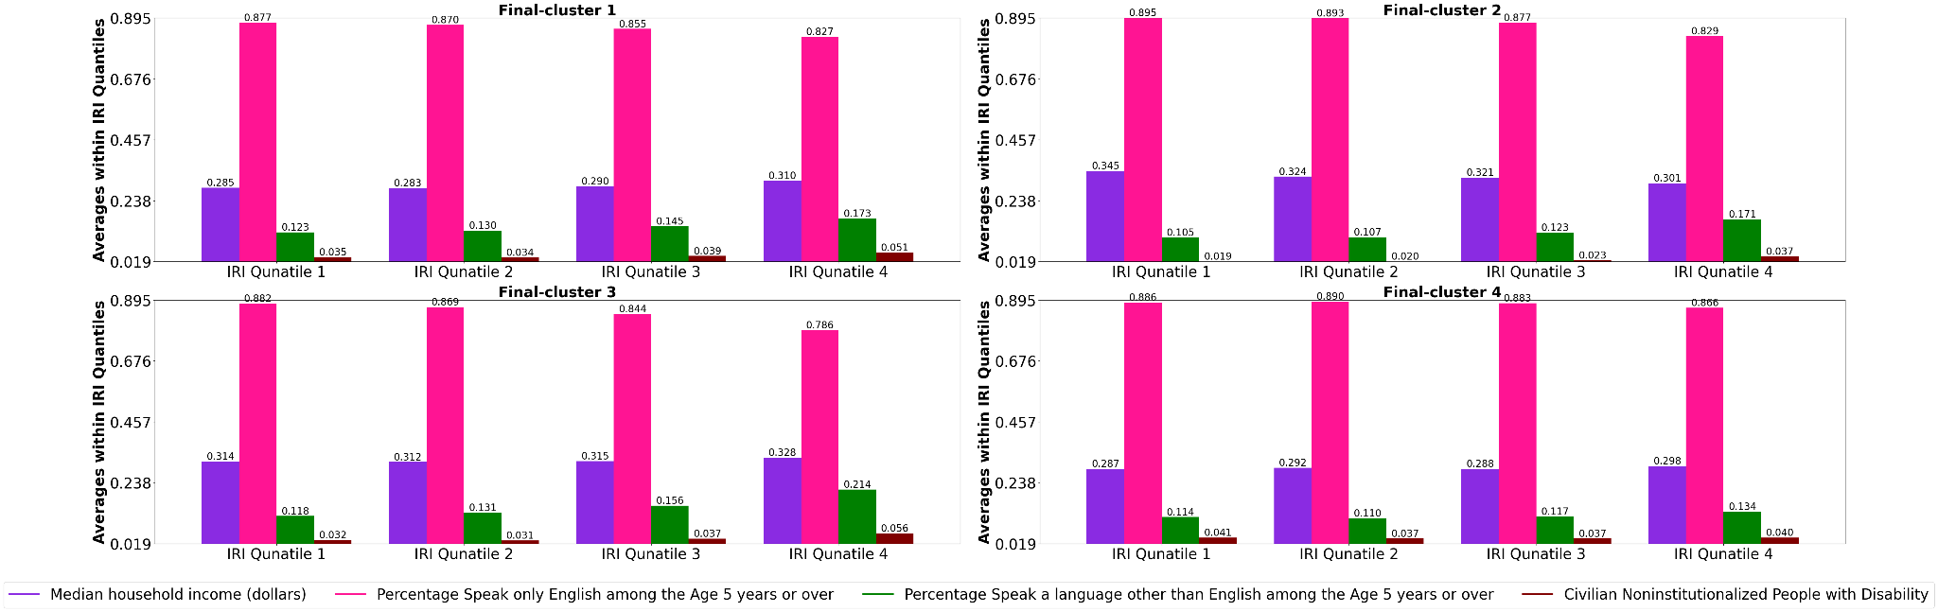
Income, Language and Disability on Pavement Quality
Higher income in Clusters 1 and 4 links to better pavement quality
Non-English speakers increase, and English-only speakers decrease as pavement quality decreases
Poor pavement quality is linked to increased disability rates

Slide 30
Key Notes on Inequitable Pavement Access
Two-step Cluster Analysis reveals distinct socio-economic patterns in pavement quality.
  K-means clustering methods are useful to initialize the pre-clusters from raw data.
Agglomerative clusters are computationally sensitive
Poorer pavement regions show:
      Significant racial composition changes.
  Higher language barriers (non-English speakers).
  Increased disability concentrations.
  Educational attainment and employment rates influence pavement accessibility.

Slide 31
Future Works
Investigating combined effects of the socioeconomic features with Explainable Artificial Intelligence (XAI)
Including socioeconomic index such as
Different age groups, income levels, educational attainments
Optimize cluster numbers for large datasets using Particle Swarm Optimization (PSO).
Experiment with other two-step clustering frameworks, including
K-means++ and Agglomerative Clustering

Slide 32
References
Seyedrezaei, M., B. Becerik-Gerber, M. Awada, S. Contreras, and G. Boeing. (2023). "Equity in the built environment: A systematic review." Building and Environment 110827”
Townsend, C. E. (2022). Leveraging AI to assess inequities in pavement maintenance and rehabilitation strategies. Master’s Thesis, Department of Civil Engineering, University of Missouri-Columbia,https://mospace.umsystem.edu/xmlui/handle/10355/95170 , accessed 30th March 2024.
Radovic, M., O. Ghonima, and T. Schumacher. (2017). Data mining of bridge concrete deck parameters in the national bridge inventory by two-step cluster analysis. ASCE-ASME Journal of Risk and Uncertainty in Engineering Systems, Part A: Civil Engineering 3(2), F4016004.
Moscoso, Y. F., Rincón, L. F., Leiva-Maldonado, S. L., & ASC Campos e Matos, J. (2024). Bridge deterioration models for different superstructure types using Markov chains and two-step cluster analysis. Structure and Infrastructure Engineering, 20(6), 791-801.
U. S. Government Accountability Office (GAO). (2022). National Highways: Analysis of Available Data Could Better Ensure Equitable Pavement Condition. GAO-22-104578
Erfani, A., J. Mahmoudi, & Q. Cui. (2024). Measuring Social Equity in Pavement Conditions Using Big Data. In Construction Research Congress 2024 pp. 23-32.

Slide 33
Question and Answering

Slide 34
Thank you

